Slide 1
Oral Cancer
Detection
Team Members:
Harikrishnan. S
Jumana Mariyam
Sneha Elizabeth S
Unnikrishnan M.S

Slide 2
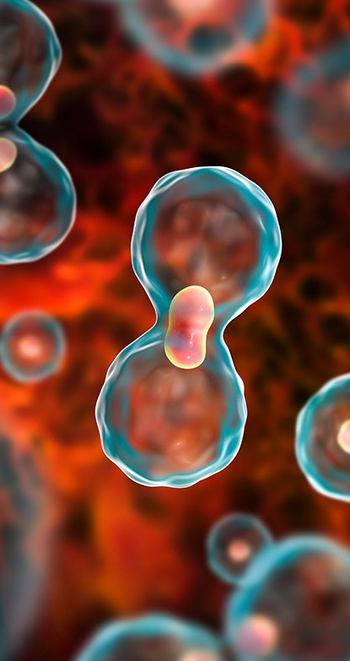
Introduction
Early detection is crucial in the fight against oral cancer. Our project aims to leverage the power of artificial intelligence (AI) to create a user-friendly mobile application that can assist in the early identification of potential oral cancer symptoms.
This app utilizes a ResNet-based deep learning model, trained to analyze images of oral lesions. By integrating this model within the app, we strive to empower individuals to proactively monitor their oral health and potentially detect concerning signs at an earlier stage.

Slide 3
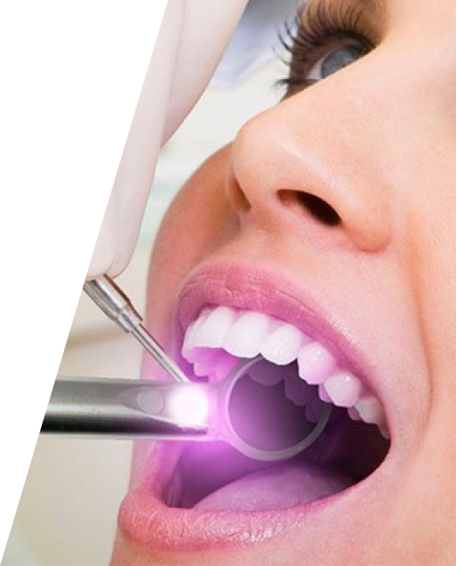
Objective
The Objective of this project is to harness the power of deep learning to develop a mobile application for the early detection of oral cancer using images.
We aim to create a robust deep learning model capable of accurately classifying oral images into three distinct categories: precancerous, normal, and cancerous.

Slide 4
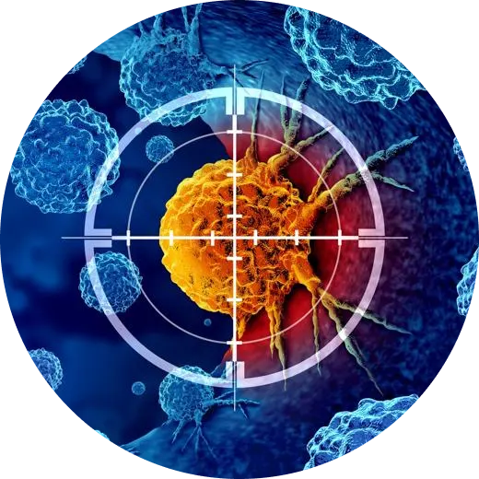
Existing System
The conventional method for oral cancer detection primarily relies on biopsy procedures, which are both costly and painful, making them inaccessible to a significant portion of the population due to financial constraints.
Existing models lack adequate representation of oral lesions, with issues such as insufficient standardization in image acquisition and limited diversity in intraoral pathology for training.
Inherent limitations include small sample sizes, imbalanced class distributions, and potential biases within the dataset, affecting generalizability and robustness.
Interpretive capacity may be hindered by complex classification outcomes and a lack of clear insights into contributing factors.
Existing solutions often have large model sizes and rely on cloud-based deployment, limiting accessibility and scalability.

Slide 5
Proposed system
Introduces a novel solution that overcomes the constraints of traditional biopsy procedures and enhances accessibility to early detection services.
Our system enhances the accuracy and reliability of oral cancer screening, by making use of Resnet for feature extraction and CNN for classification, providing a robust framework for identifying pre-cancerous and cancerous lesions with better precision.
The development of a user-friendly mobile application interface ensures widespread accessibility to the screening tool, enabling individuals from diverse socioeconomic backgrounds to avail themselves of early detection services conveniently.
By facilitating real-time image analysis and prediction, our system empowers users to make informed decisions regarding their oral health status promptly, without the need for specialized equipment or invasive procedures.

Slide 6
Model Used
Feature Extraction: ResNet101
ResNet101 is a deep convolutional neural network architecture that has achieved remarkable success in various computer vision tasks, including image classification and feature extraction. Developed by Microsoft Research, ResNet (short for Residual Network) introduced the concept of residual learning, which addresses the challenge of training very deep neural networks by using skip connections or "residual blocks" to facilitate gradient flow during training.
After feature extraction using ResNet101, a total of 100,352 features are obtained from the input images. These features encapsulate rich information about the oral lesions present in the images and serve as the input to subsequent stages of the classification process. By leveraging the comprehensive feature representation provided by ResNet101, our model can effectively discriminate between different classes of oral lesions and make accurate predictions regarding the presence of pre-cancerous or cancerous conditions.

Slide 7
Classification
Sequential CNN
Classification is a fundamental task in machine learning and pattern recognition, wherein the goal is to categorize input data into predefined classes or categories based on their features or attributes. It involves training a model to learn the underlying patterns or relationships in the data and predict the correct class labels for new, unseen instances.
In our work, we have developed a Sequential Convolutional Neural Network (CNN) model for the purpose of classification into three categories: Normal, Pre-cancer, and Oral cancer. CNNs are a type of deep learning architecture specifically designed for processing structured grid-like data, such as images. They consist of multiple layers, including convolutional layers, pooling layers, and fully connected layers, which enable hierarchical feature extraction and learning. The Sequential CNN model serves as the classification component of our system, responsible for predicting the class labels of oral images based on the features extracted from ResNet101.

Slide 8
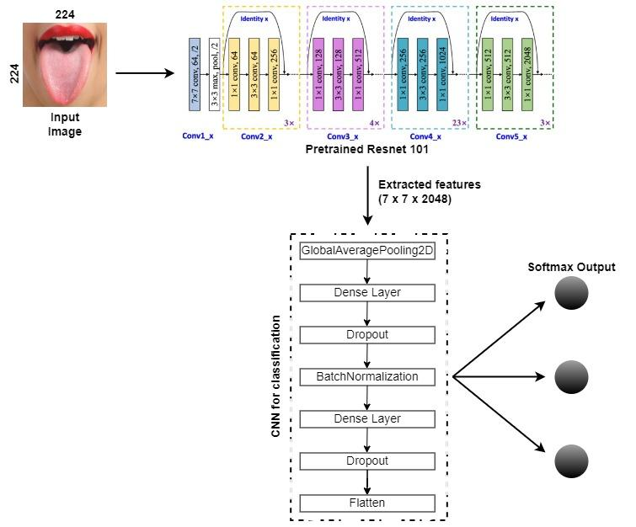
System Architecture

Slide 9
Dataset Used
We have used data collected from Cochin Cancer Research Centre, which consists of 1406 images in total.
Pre-cancerous
Normal
Cancer
509
359
538

Slide 10

Manual Cropping
Texts and other unwanted regions in the images were cropped manually to focus solely on the oral lesions of interest.
01
Resizing
All images were resized to a standardized dimension of 224x224 pixels. This resizing operation maintained consistency across the dataset and reduced computational complexity during model training.
02
Data Preprocessing
Contrast Enhancement
The Recursive Mean-Separate Histogram Equalization (RMSHE) technique was applied to enhance the contrast of images to highlight essential areas within the images, improving visual clarity and feature extraction.
03
04
Augmentation
To augment the dataset and increase variability, a series of transformations such as rotation, flipping, and scaling were applied to the images.

Slide 11
Packages Used
Tensorflow
Keras
Matplotlib

Slide 12
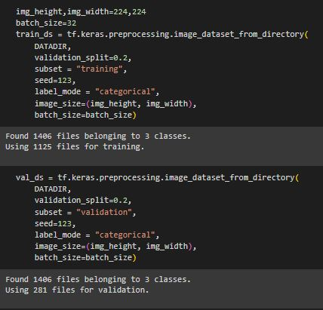
Results and Discussion
Train_Test Split

Slide 13
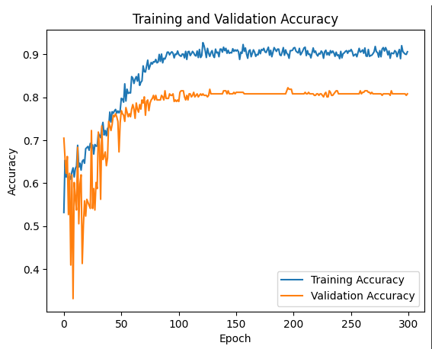
Results and Discussion
Accuracy

Slide 14
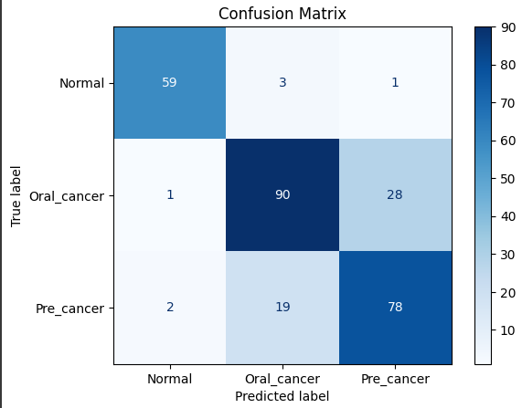
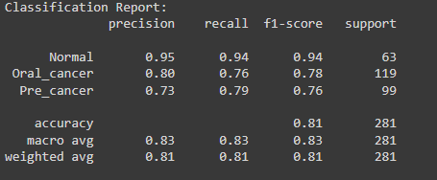
Results and Discussion
Confusion matrix
Classification report

Slide 15
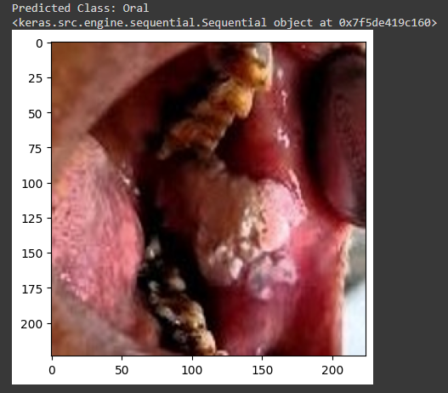
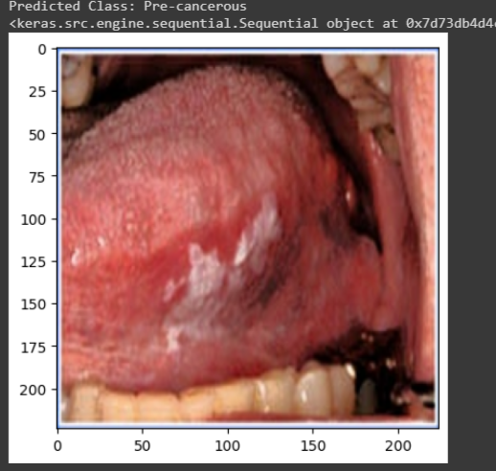
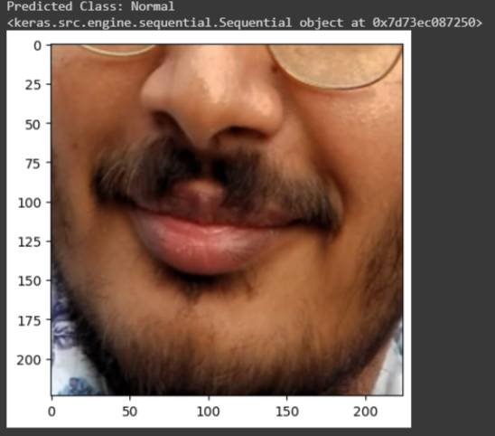
Results and Discussion
Prediction Generated

Slide 16
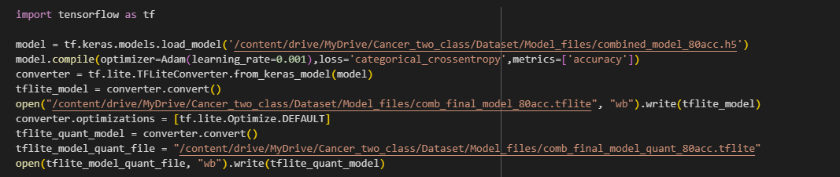

Results and Discussion
Quantization

Slide 17
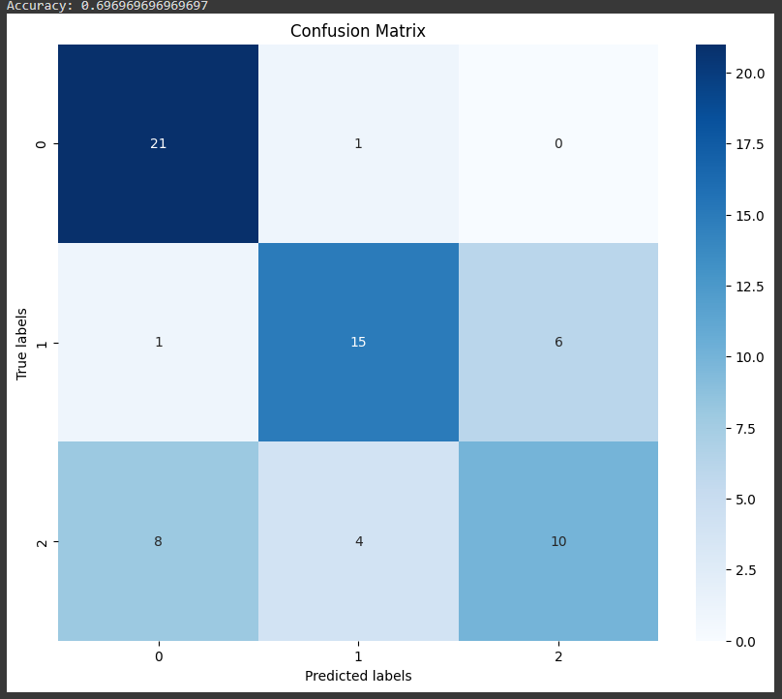
Results and Discussion
Confusion matrix obtained from quantized tflite model
Accuracy: 69%

Slide 18
Mobile Application
Framework Used: React Native
React Native (also known as RN) is a popular JavaScript-based mobile app framework that allows you to build natively-rendered mobile apps for iOS and Android.
The framework lets you create an application for various platforms by using the same codebase.
By using React Native, companies can create code just once and use it to power both their iOS and Android apps. This translates to huge time and resource savings.
React Native was built based on React – a JavaScript library, which was already hugely popular when the mobile framework was released.
The framework empowered frontend developers, who could previously only work with web-based technologies, to create robust, production-ready apps for mobile platforms.

Slide 19
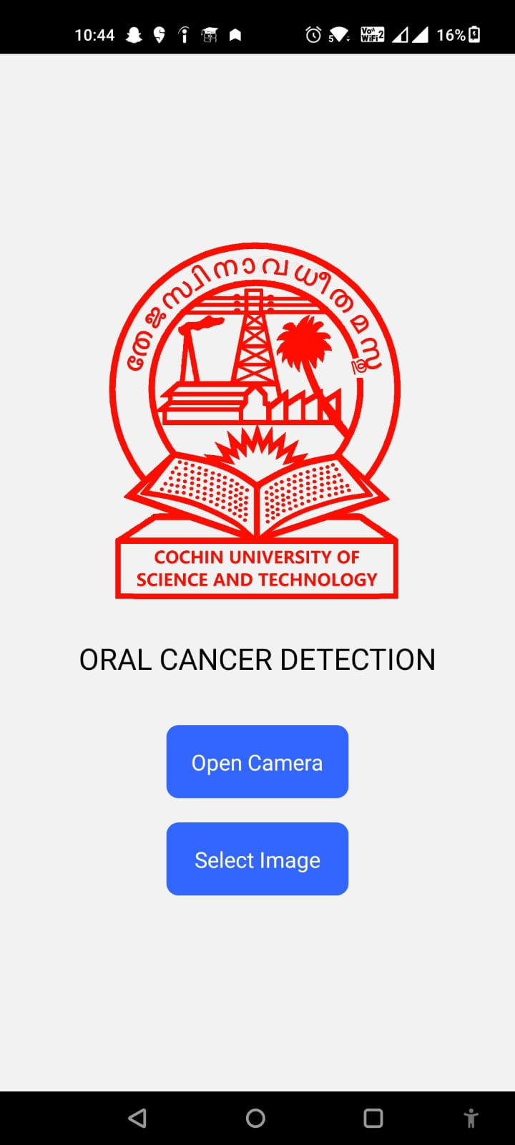
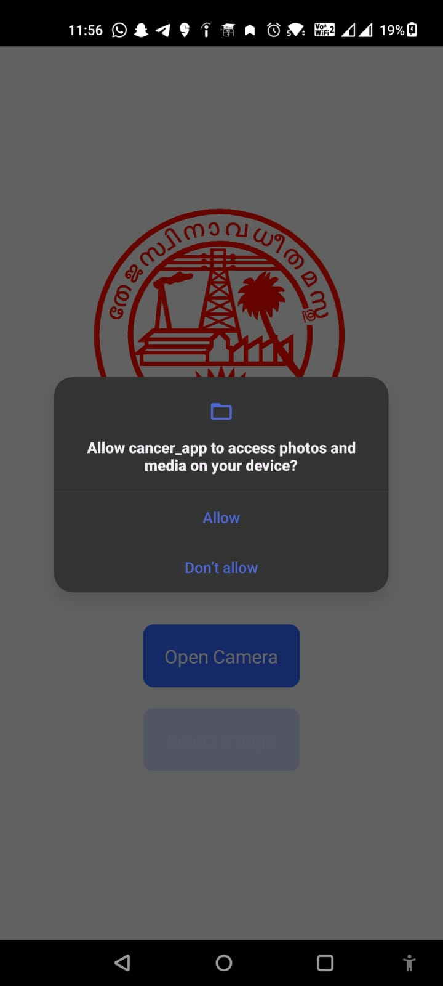
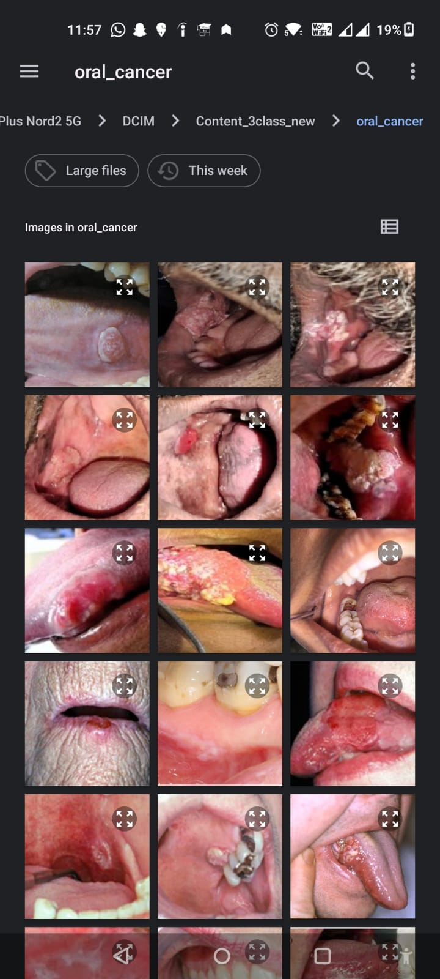
Application Interface

Slide 20
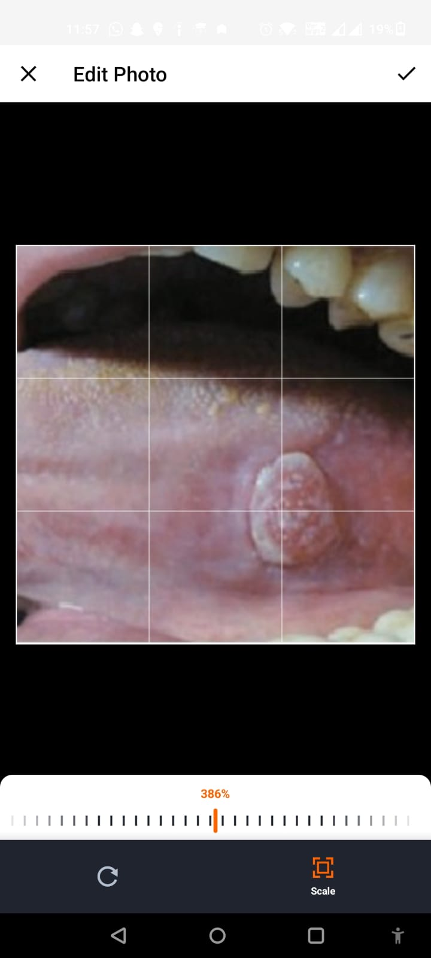
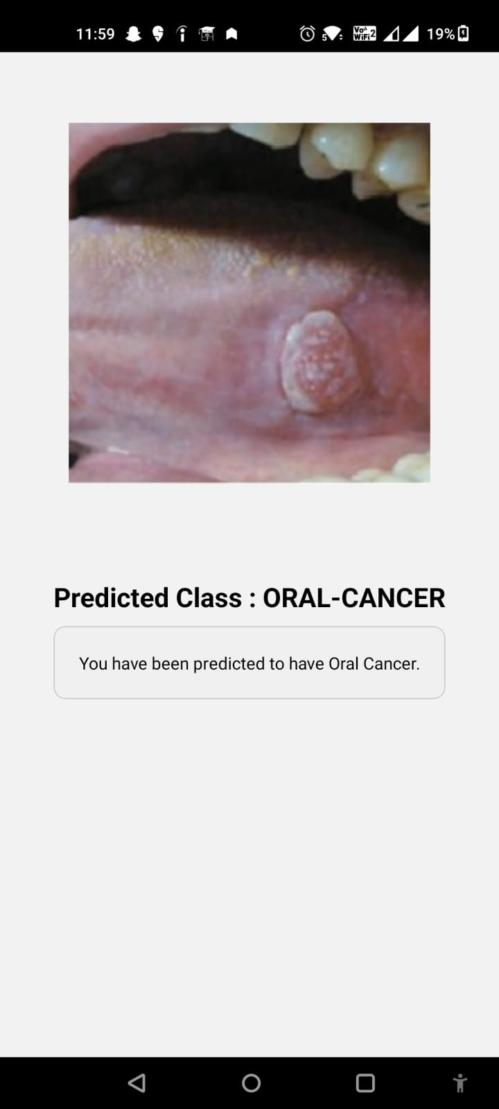
Application Interface

Slide 21
Future Scope
Incorporating More Categories: Currently, the prediction model classifies oral images into three categories: normal, oral cancer, and pre-cancer. In the future, additional distinctions within these categories could be explored with the availability of relevant data. This expansion could enable more granular classification, enhancing the model's diagnostic capabilities and providing deeper insights into oral health conditions.
Acquisition of More Data and Model Performance Improvement: Continuous efforts should be made to acquire larger and more diverse datasets to further improve the performance of the prediction model. Increasing the variety and quantity of data available for training can enhance the model's ability to generalize to unseen cases and improve its accuracy and reliability in real-world scenarios.

Slide 22
Future Scope
Incorporating More Functionalities in the Mobile App: The mobile application for oral cancer detection can be enhanced with additional functionalities to improve user experience and utility. For example, features such as real-time feedback, educational resources on oral health, and integration with wearable devices for continuous monitoring could be incorporated to provide a comprehensive oral health management platform.
Integration with Electronic Health Records (EHR): By Integrating the developed oral cancer detection system with electronic health record (EHR) systems, healthcare providers can access comprehensive patient histories and make well-informed decisions. Furthermore, leveraging longitudinal data from EHRs for retrospective analysis and outcome prediction can provide valuable insights into disease progression and treatment efficacy, guiding future research and clinical practice. This integration can lead to improved patient outcomes and more efficient healthcare delivery.

Slide 23
Demo

Slide 24

CONCLUSION
The app empowers individuals to take a more proactive role in monitoring their oral health. It can raise awareness about oral cancer symptoms and encourage regular self-screening. The app can serve as a valuable tool, particularly in areas with limited access to health care, by prompting users to seek professional evaluation when necessary.
However, it's important to reiterate that the app is for informational purposes only. A professional diagnosis from a dentist or healthcare provider remains essential.
We envision this app to be used be used for early detection suspicious lesions which can lead to timely professional diagnosis and treatment. By combining user awareness with AI-powered analysis, our project has the potential to contribute significantly to early detection and improved oral health outcomes.

Slide 25
THANK YOU!

